Slide 1
ICT-LEARNFACTORY
Multi-User-Applikationen
objektorientiert realisieren
Modellierung
08/16/26
Notes:
[Sources]
- Redesign follows the supplied ICT-LearnFactory Brand Guide (Aptos typography; Charcoal Flux #272726, Hyper Teal #45D9C7, Lumen Zest #D9EB12, Abyss Teal #29948C; geometric brand-mark pattern language).
- Slide content is preserved from the uploaded source presentation 03_Modellierung.odp.
[/Sources]

Slide 2
Handlungsnotwendige Kenntnisse
3.3 Kennt die Umsetzung einer objekt-relationalen Abbildung eines Geschäftsobjektmodells und deren Spezifikation mittels UML (Klassendiagramm, Sequenzdiagramm).
5.1 Kennt Möglichkeiten zur Dokumentation von Transaktionen im DBMS und in der Applikation.
ICT-LEARNFACTORY
Modellierung
Notes:
[Sources]
- Redesign follows the supplied ICT-LearnFactory Brand Guide (Aptos typography; Charcoal Flux #272726, Hyper Teal #45D9C7, Lumen Zest #D9EB12, Abyss Teal #29948C; geometric brand-mark pattern language).
- Slide content is preserved from the uploaded source presentation 03_Modellierung.odp.
[/Sources]

Slide 3
Ziele
Du kennst statische und dynamische Analysemodelle
ICT-LEARNFACTORY
Modellierung
Notes:
[Sources]
- Redesign follows the supplied ICT-LearnFactory Brand Guide (Aptos typography; Charcoal Flux #272726, Hyper Teal #45D9C7, Lumen Zest #D9EB12, Abyss Teal #29948C; geometric brand-mark pattern language).
- Slide content is preserved from the uploaded source presentation 03_Modellierung.odp.
[/Sources]

Slide 4
Analyse
Vorgehen
Klassen identifizieren
Z.B. Person, Firma, etc
ICT-LEARNFACTORY
Modellierung
Notes:
[Sources]
- Redesign follows the supplied ICT-LearnFactory Brand Guide (Aptos typography; Charcoal Flux #272726, Hyper Teal #45D9C7, Lumen Zest #D9EB12, Abyss Teal #29948C; geometric brand-mark pattern language).
- Slide content is preserved from the uploaded source presentation 03_Modellierung.odp.
[/Sources]

Slide 5
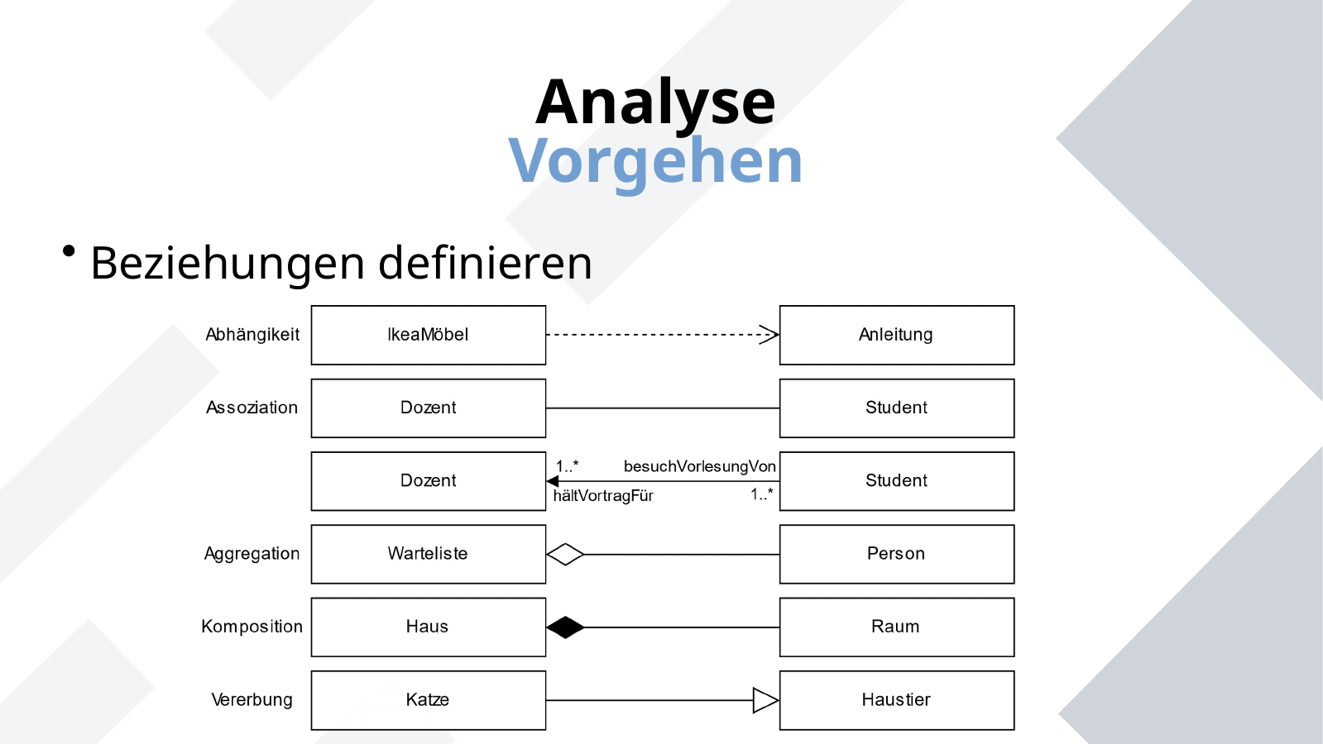
Analyse
Vorgehen
Beziehungen definieren
ICT-LEARNFACTORY
Modellierung
Notes:
[Sources]
- Redesign follows the supplied ICT-LearnFactory Brand Guide (Aptos typography; Charcoal Flux #272726, Hyper Teal #45D9C7, Lumen Zest #D9EB12, Abyss Teal #29948C; geometric brand-mark pattern language).
- Slide content is preserved from the uploaded source presentation 03_Modellierung.odp.
[/Sources]

Slide 6
Analyse
Vorgehen
Attribute identifizieren
Z.B. Name, Vorname bei Person
Funktionen identifizieren
Z.B. “bestätigen” bei Bestellung
Vererbung
Haben mehrere Objekte gleiche Attribute, kann eine (abstrakte) Oberklasse definiert werden
Z.B. Natürliche und juristische Person
ICT-LEARNFACTORY
Modellierung
Notes:
[Sources]
- Redesign follows the supplied ICT-LearnFactory Brand Guide (Aptos typography; Charcoal Flux #272726, Hyper Teal #45D9C7, Lumen Zest #D9EB12, Abyss Teal #29948C; geometric brand-mark pattern language).
- Slide content is preserved from the uploaded source presentation 03_Modellierung.odp.
[/Sources]

Slide 7
Analyse
Vorgehen
Zusammenfassen
Inhaltlich “benachbarte” Klassen zu einem Package zusammenfassen
Ergebnisse der statischen Modellierung sind folgende Strukturdiagramme
Klassendiagramm
Paketdiagramm
ICT-LEARNFACTORY
Modellierung
Notes:
[Sources]
- Redesign follows the supplied ICT-LearnFactory Brand Guide (Aptos typography; Charcoal Flux #272726, Hyper Teal #45D9C7, Lumen Zest #D9EB12, Abyss Teal #29948C; geometric brand-mark pattern language).
- Slide content is preserved from the uploaded source presentation 03_Modellierung.odp.
[/Sources]

Slide 8
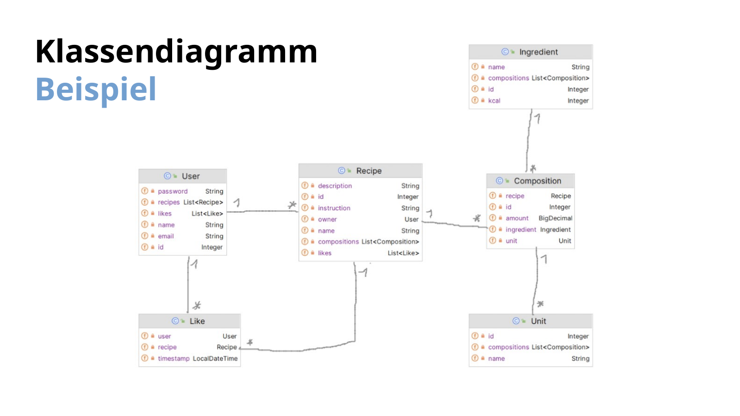
Klassendiagramm
Beispiel
ICT-LEARNFACTORY
Modellierung
Notes:
[Sources]
- Redesign follows the supplied ICT-LearnFactory Brand Guide (Aptos typography; Charcoal Flux #272726, Hyper Teal #45D9C7, Lumen Zest #D9EB12, Abyss Teal #29948C; geometric brand-mark pattern language).
- Slide content is preserved from the uploaded source presentation 03_Modellierung.odp.
[/Sources]

Slide 9
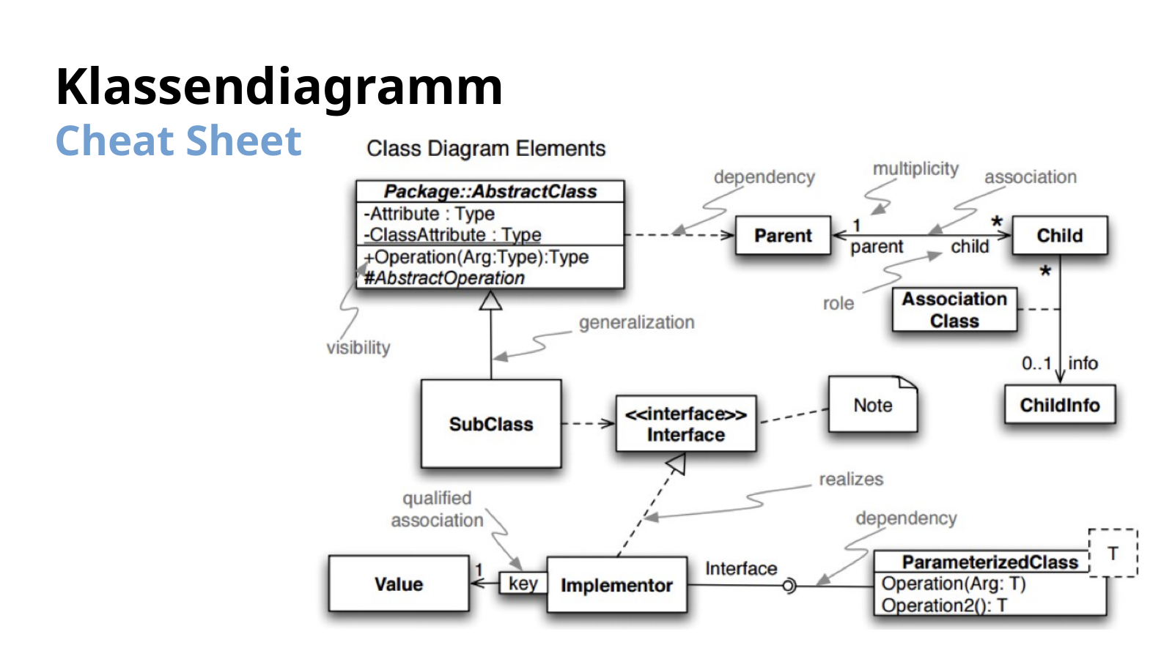
Klassendiagramm
Cheat Sheet
ICT-LEARNFACTORY
Modellierung
Notes:
[Sources]
- Redesign follows the supplied ICT-LearnFactory Brand Guide (Aptos typography; Charcoal Flux #272726, Hyper Teal #45D9C7, Lumen Zest #D9EB12, Abyss Teal #29948C; geometric brand-mark pattern language).
- Slide content is preserved from the uploaded source presentation 03_Modellierung.odp.
[/Sources]

Slide 10
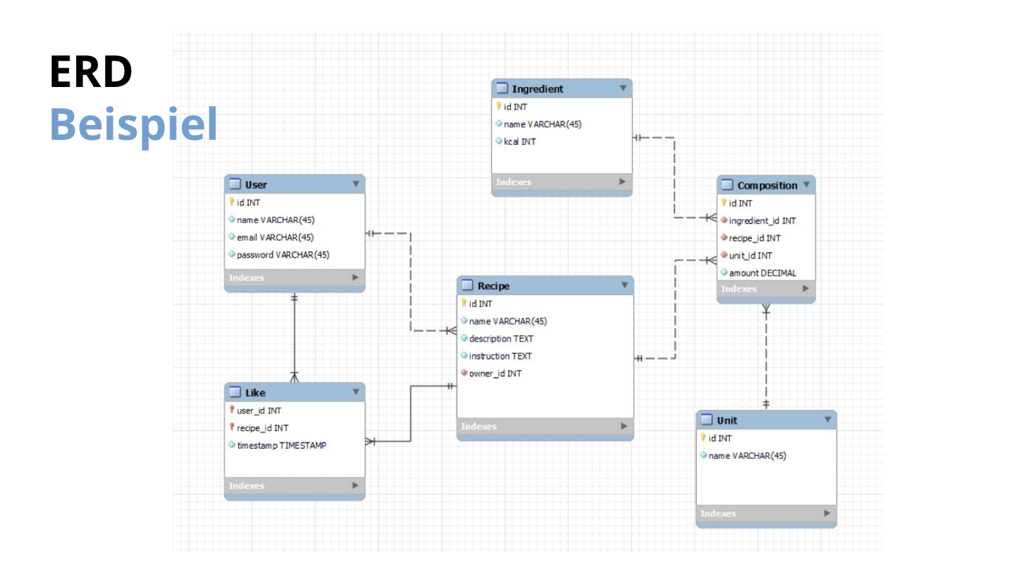
ERD
Beispiel
ICT-LEARNFACTORY
Modellierung
Notes:
[Sources]
- Redesign follows the supplied ICT-LearnFactory Brand Guide (Aptos typography; Charcoal Flux #272726, Hyper Teal #45D9C7, Lumen Zest #D9EB12, Abyss Teal #29948C; geometric brand-mark pattern language).
- Slide content is preserved from the uploaded source presentation 03_Modellierung.odp.
[/Sources]

Slide 11
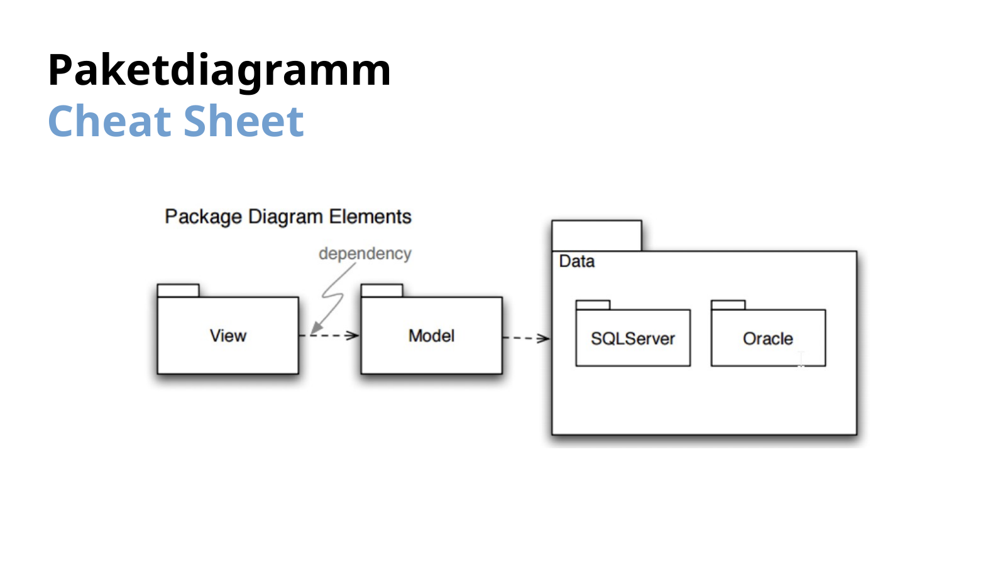
Paketdiagramm
Cheat Sheet
ICT-LEARNFACTORY
Modellierung
Notes:
[Sources]
- Redesign follows the supplied ICT-LearnFactory Brand Guide (Aptos typography; Charcoal Flux #272726, Hyper Teal #45D9C7, Lumen Zest #D9EB12, Abyss Teal #29948C; geometric brand-mark pattern language).
- Slide content is preserved from the uploaded source presentation 03_Modellierung.odp.
[/Sources]

Slide 12
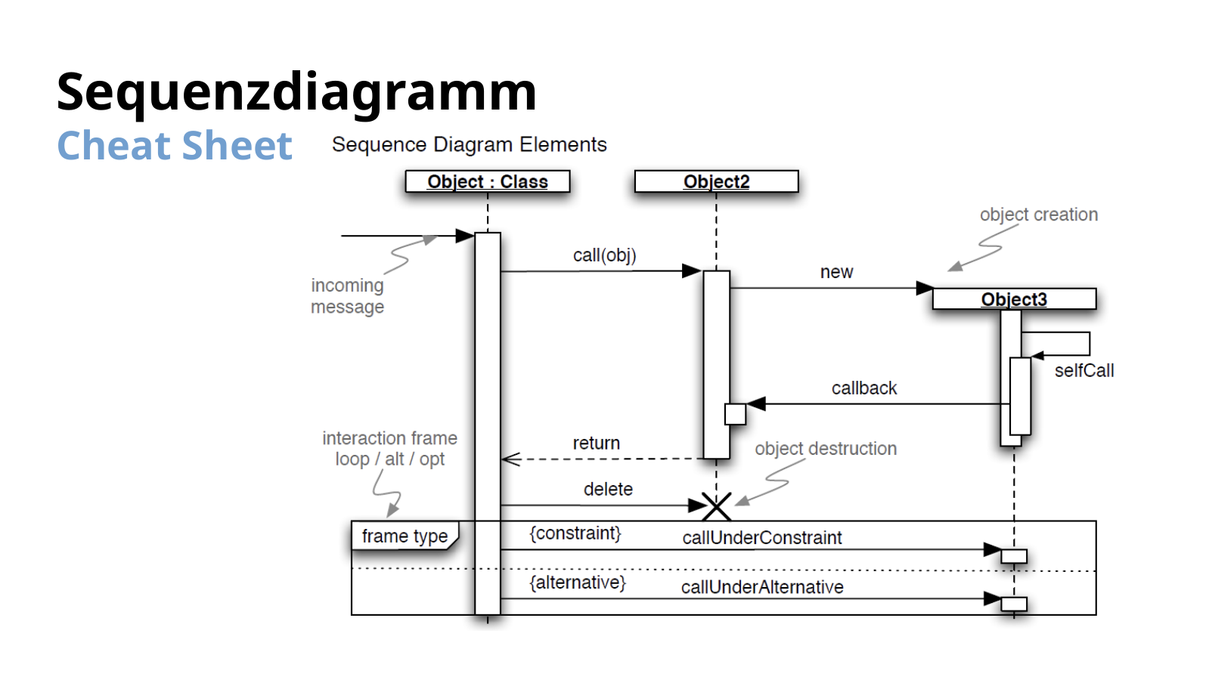
Sequenzdiagramm
Cheat Sheet
ICT-LEARNFACTORY
Modellierung
Notes:
[Sources]
- Redesign follows the supplied ICT-LearnFactory Brand Guide (Aptos typography; Charcoal Flux #272726, Hyper Teal #45D9C7, Lumen Zest #D9EB12, Abyss Teal #29948C; geometric brand-mark pattern language).
- Slide content is preserved from the uploaded source presentation 03_Modellierung.odp.
[/Sources]

Slide 13
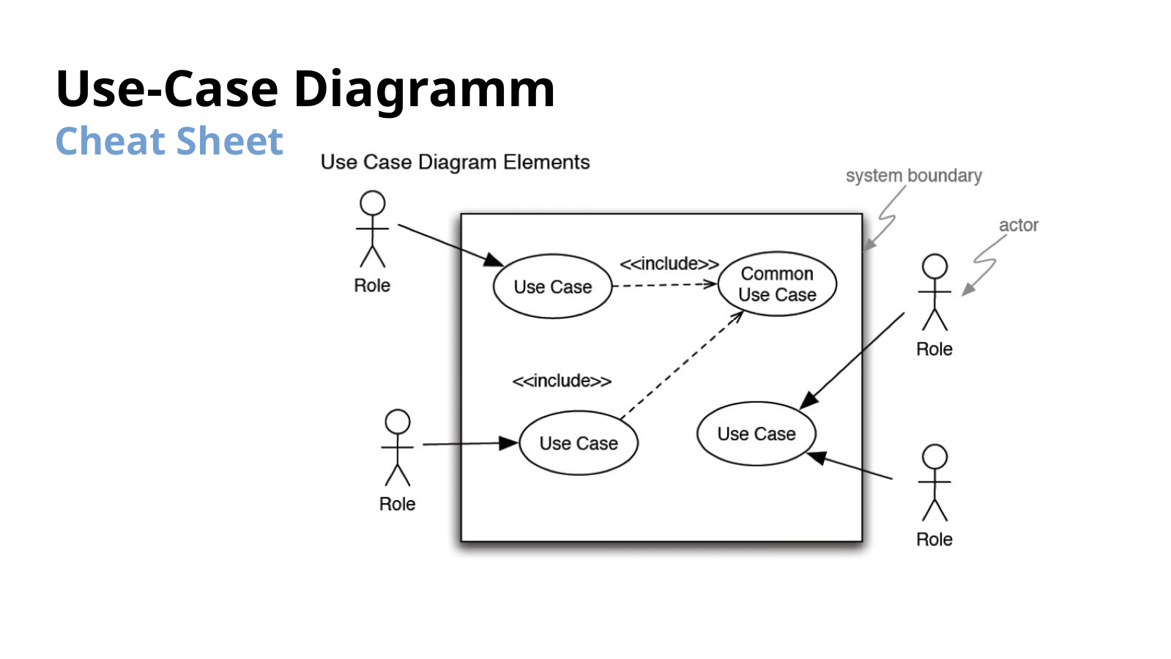
Use-Case Diagramm
Cheat Sheet
ICT-LEARNFACTORY
Modellierung
Notes:
[Sources]
- Redesign follows the supplied ICT-LearnFactory Brand Guide (Aptos typography; Charcoal Flux #272726, Hyper Teal #45D9C7, Lumen Zest #D9EB12, Abyss Teal #29948C; geometric brand-mark pattern language).
- Slide content is preserved from the uploaded source presentation 03_Modellierung.odp.
[/Sources]

Slide 14
Fragen?
ICT-LEARNFACTORY
Modellierung
Notes:
[Sources]
- Redesign follows the supplied ICT-LearnFactory Brand Guide (Aptos typography; Charcoal Flux #272726, Hyper Teal #45D9C7, Lumen Zest #D9EB12, Abyss Teal #29948C; geometric brand-mark pattern language).
- Slide content is preserved from the uploaded source presentation 03_Modellierung.odp.
[/Sources]

